Slide 1
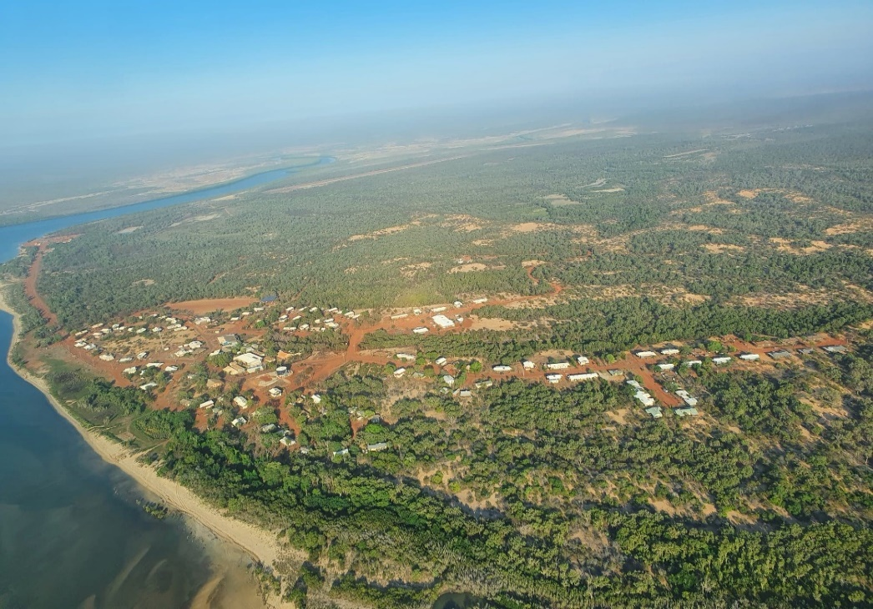
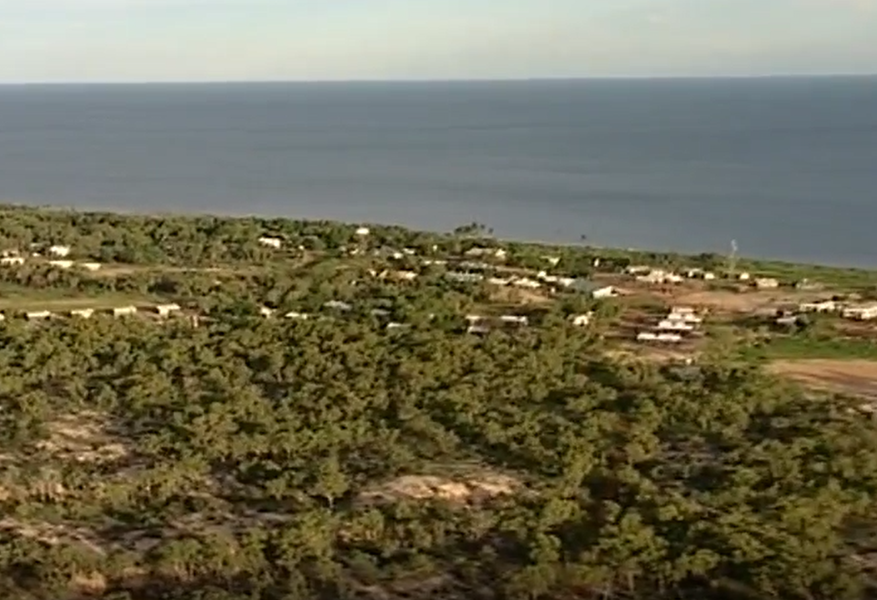
Numbulwar past and present
We have compared Numbulwar a long time ago and today

Slide 2
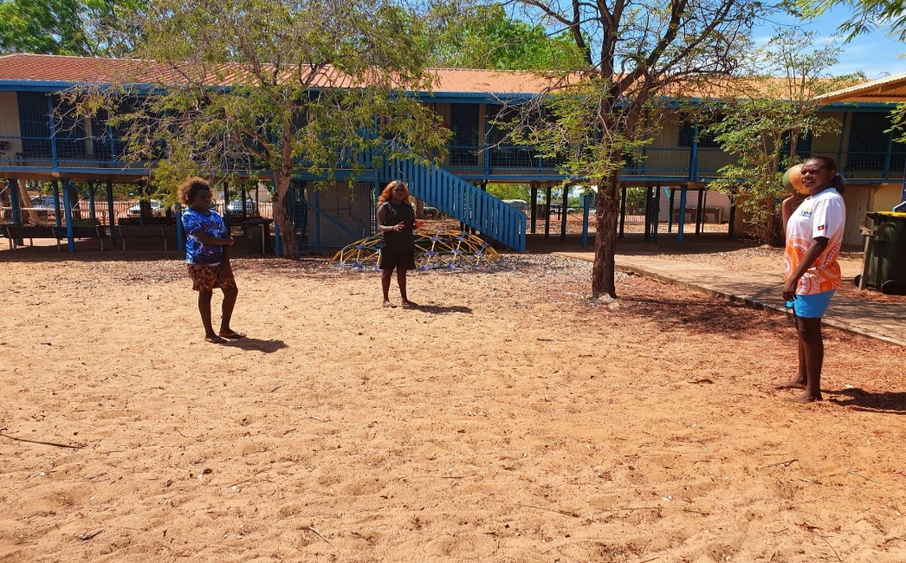
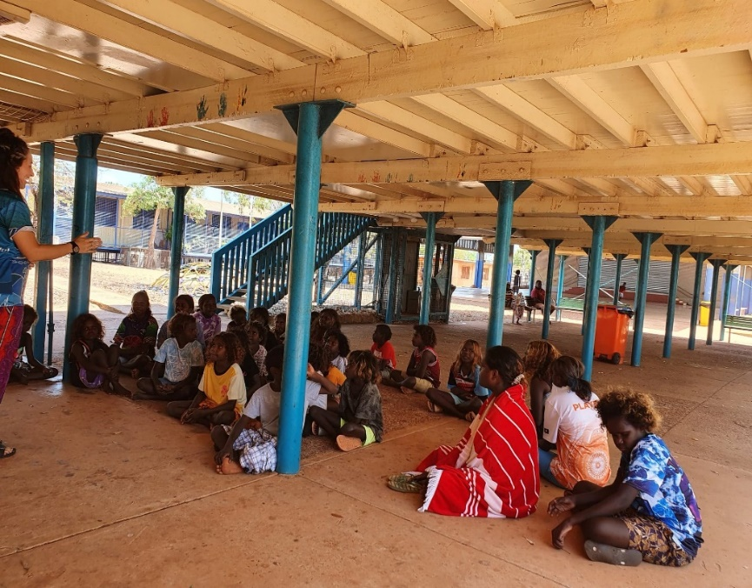
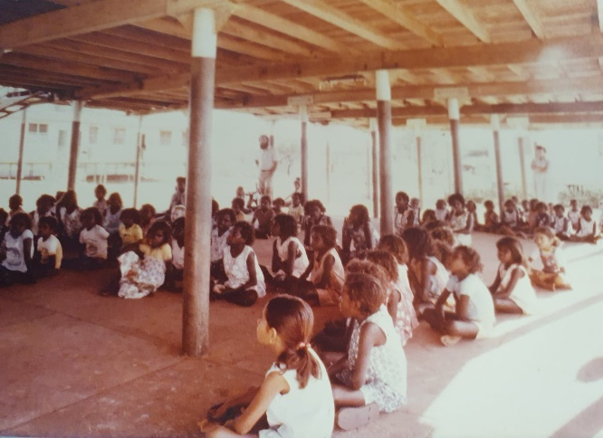
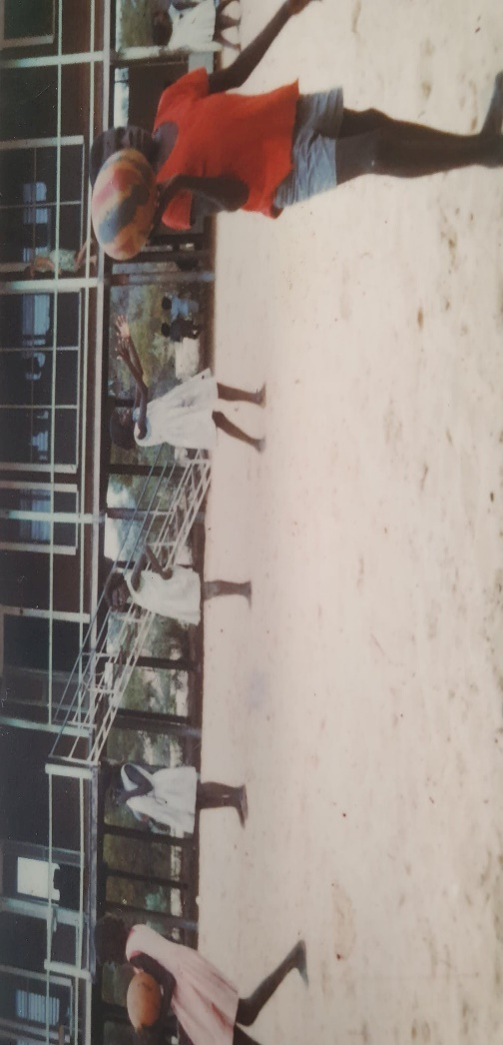
Highset
past
present
Some grass made of white wood no chair under Neath same stairs no fire hose water tap or gate
No grass blue green fence goes all the way up the roof lots of chairs blue poles canteen building foot paths fire hoes water tap lock gate same stairs

Slide 3
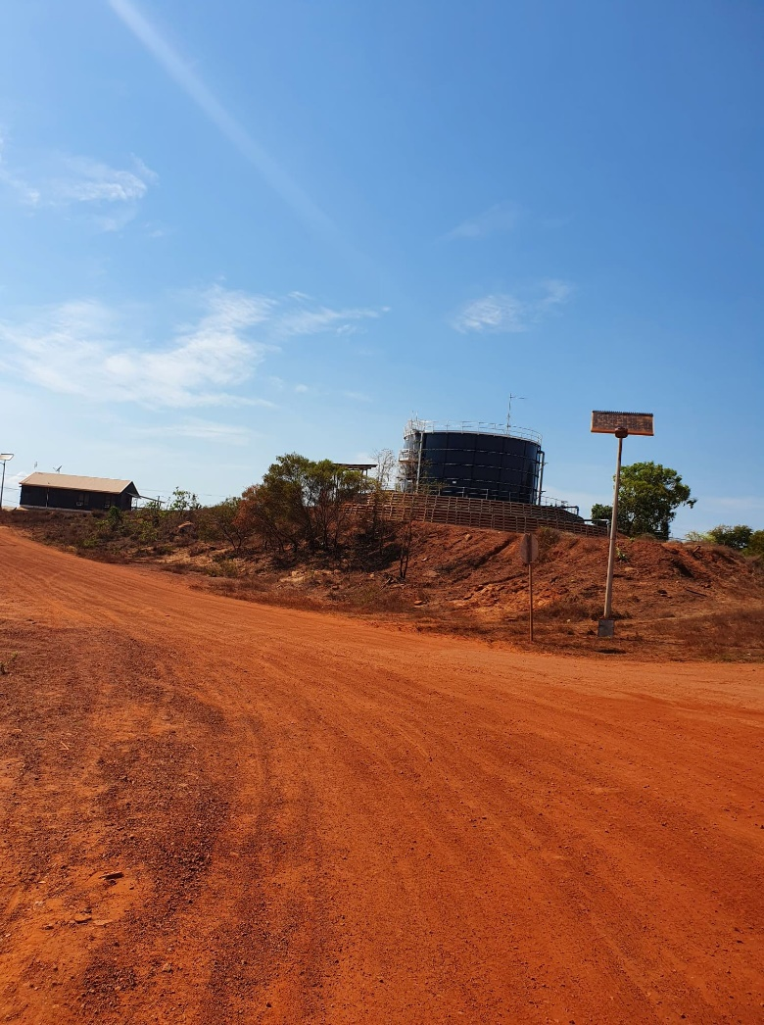
Water tank
past
Present
Its was really tall white water tank above ground used it to look were Numbulwar from a long way away up on poll no fence ladder to clam up lots of trees
Blue goes under ground too low to see it far away no poll a fence around no ladder no trees

Slide 4
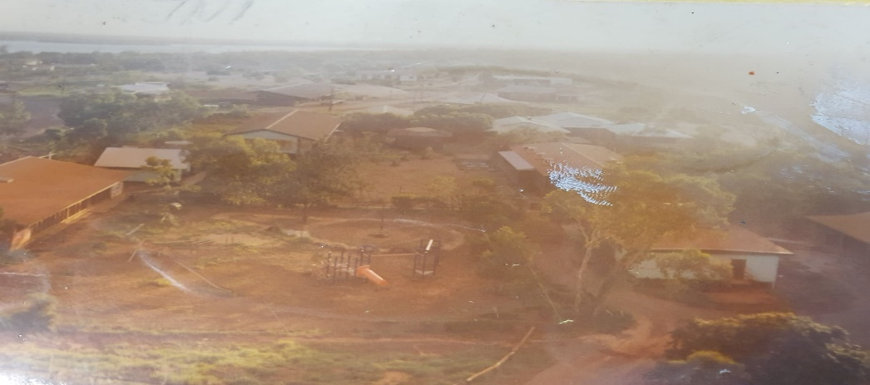
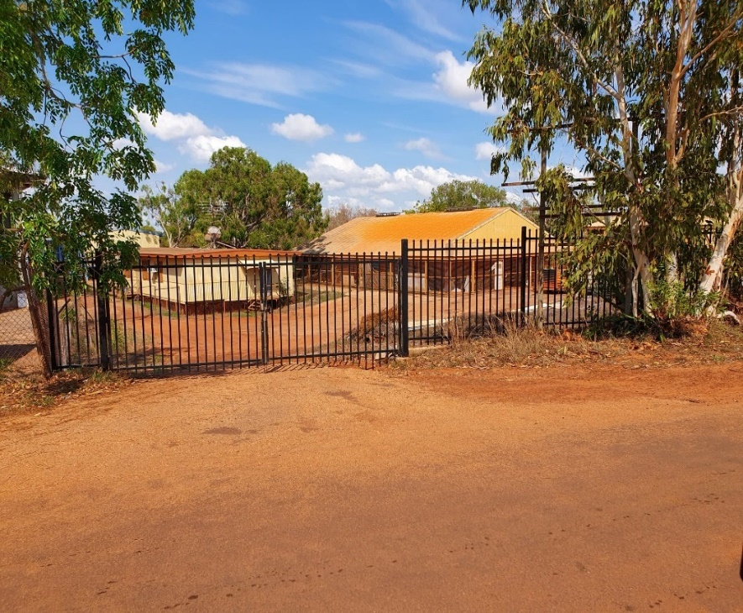
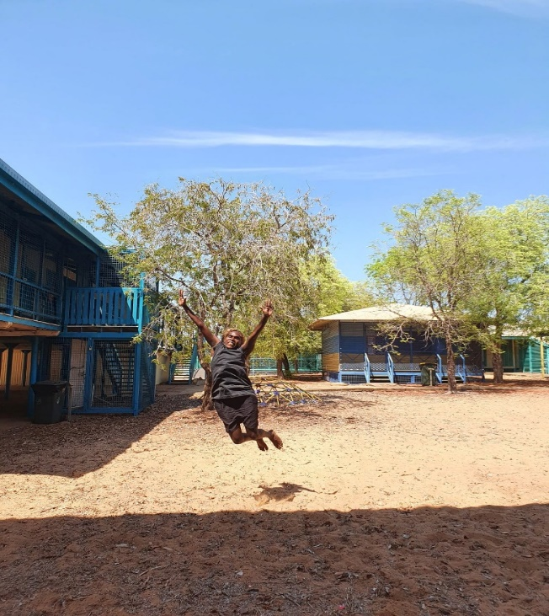
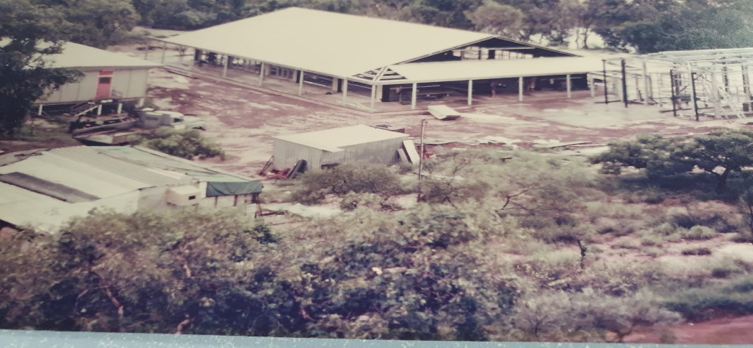
Soccer + shed secondary
past
present
Didn’t exist when built the sides were all open no secondary there was only trees
Big orange rectangular building soccer shed surrounded by concrete foot paths sec has blue gates’ a garden benches chairs ramp to go op shop music room toilets cafe

Slide 5
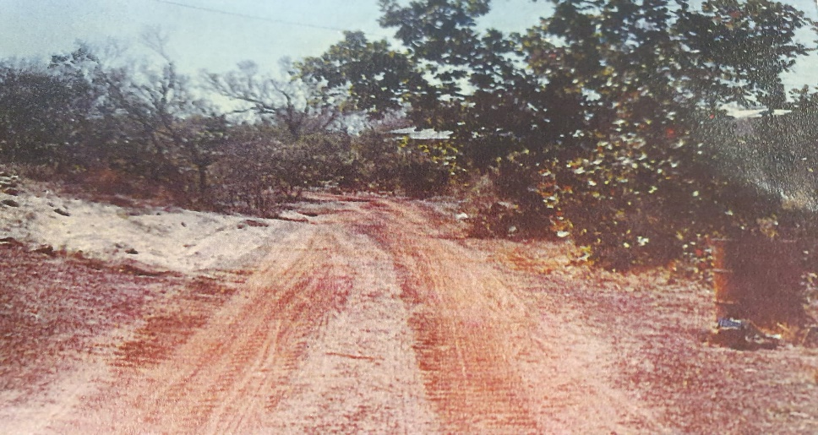
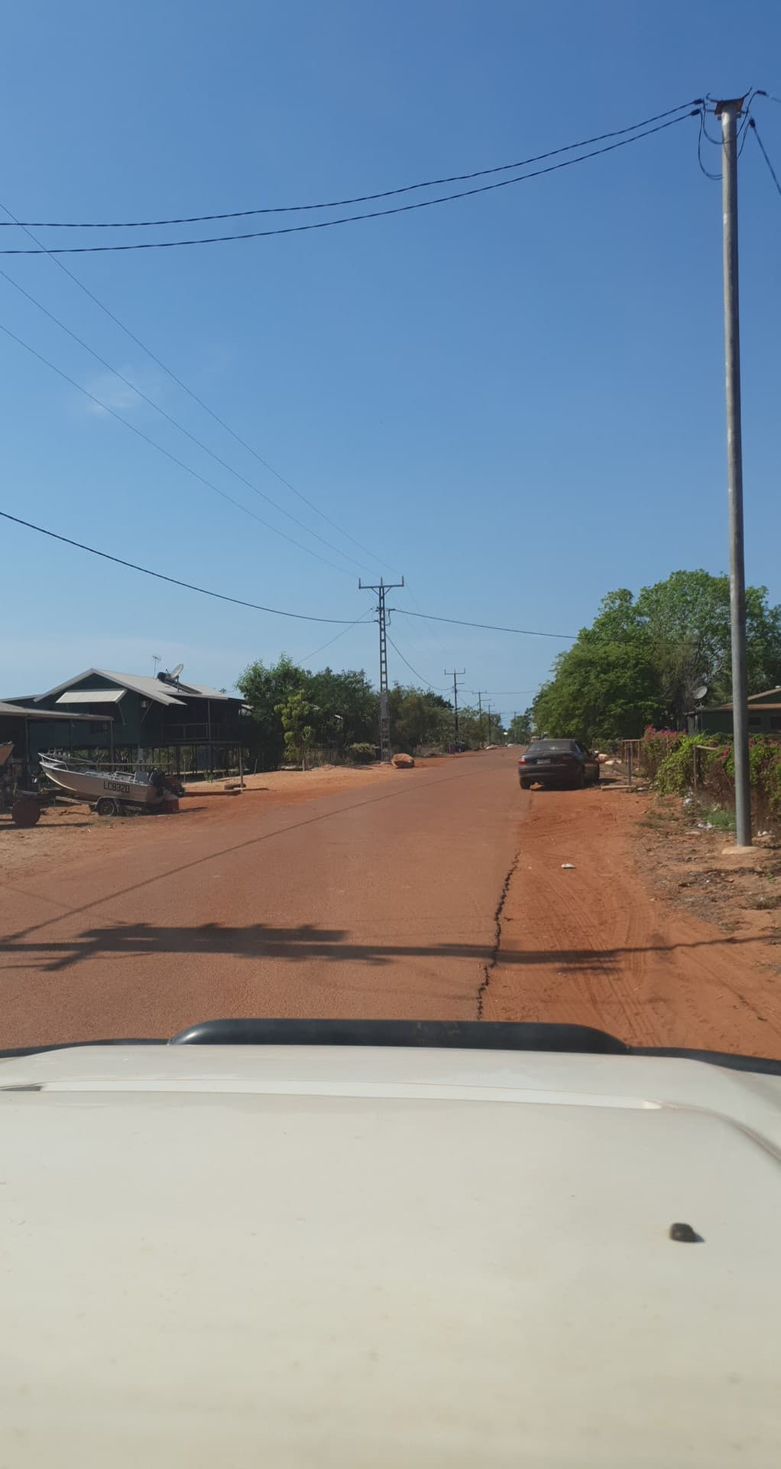
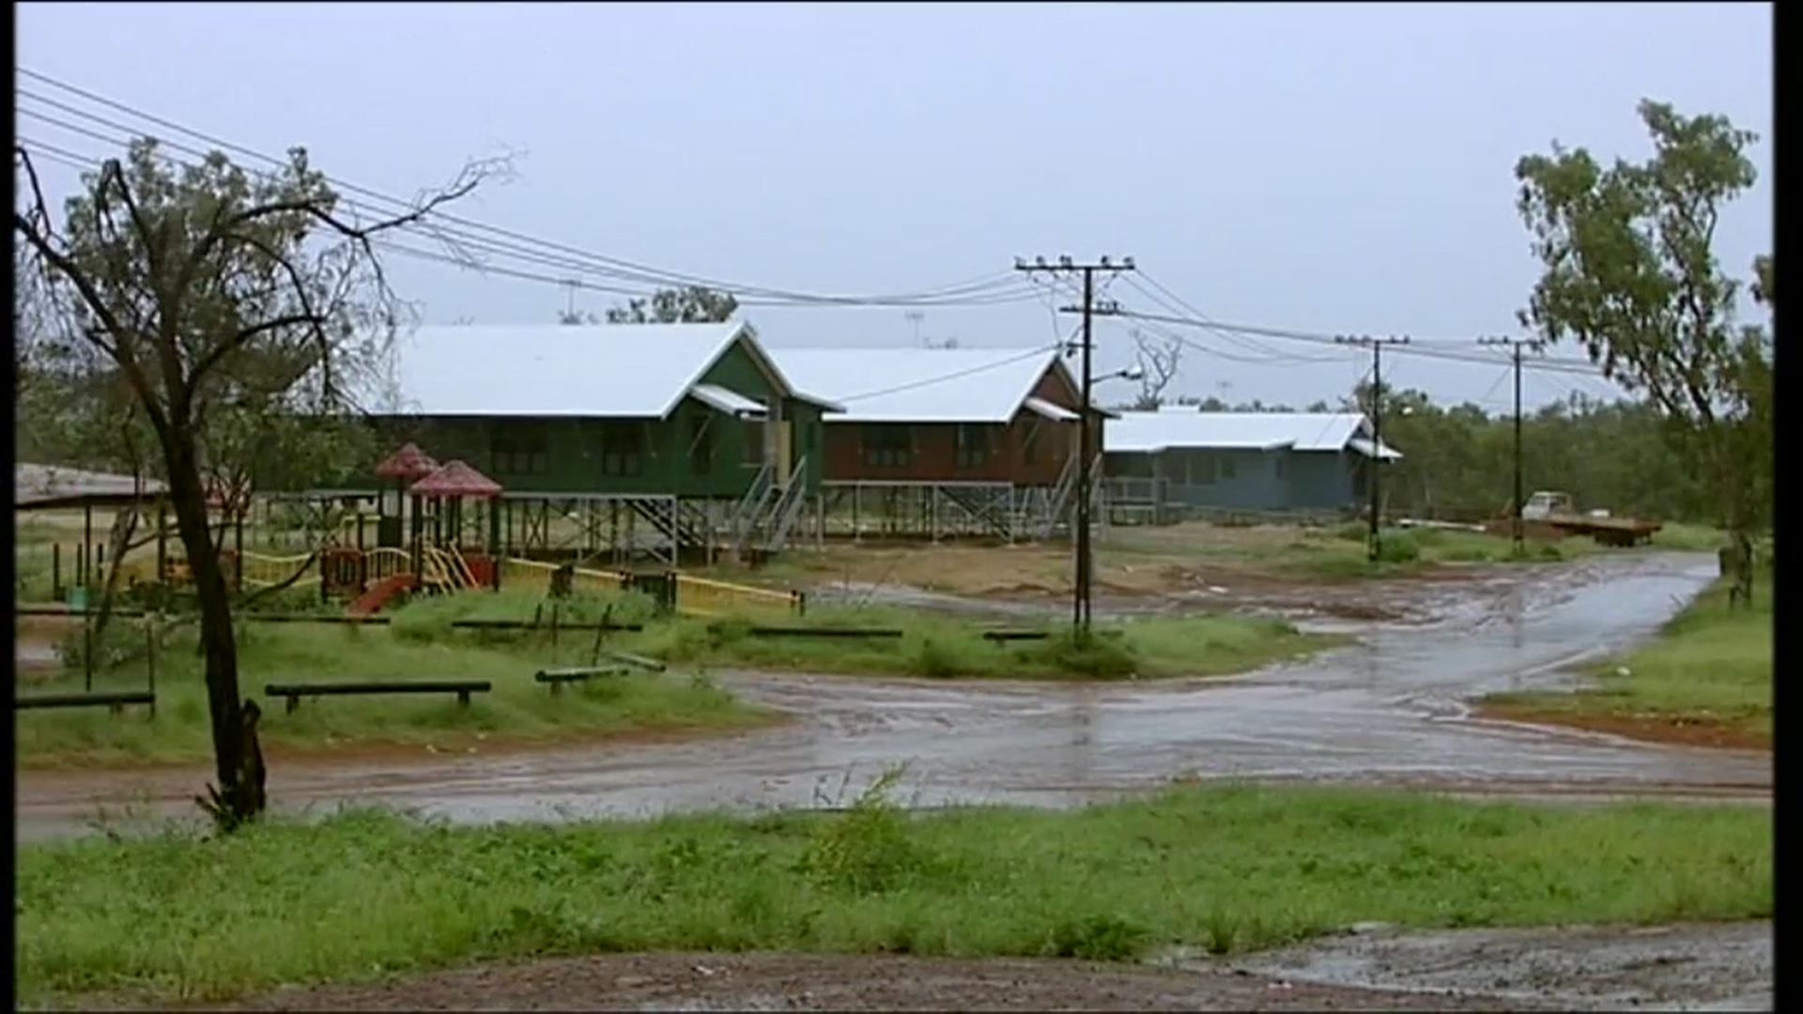
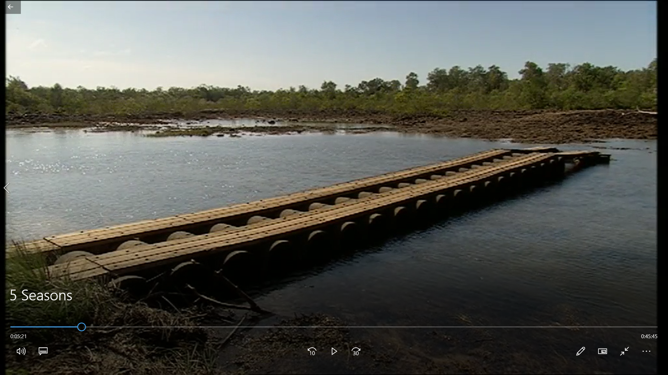
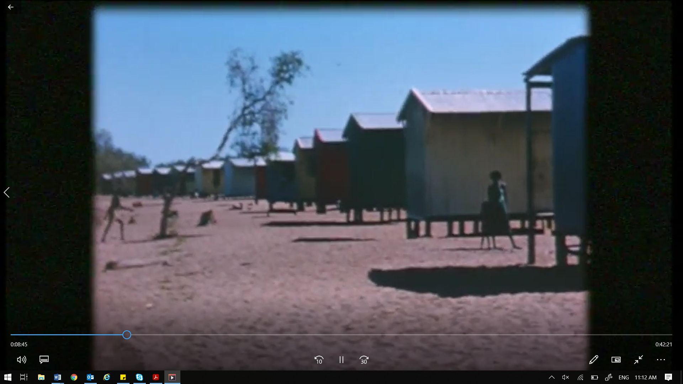
Road + house
past
Present
Wandu crossing lots of concrete cylinders planks of wood for tyres walk by foot to wandu for 7days sandy roads
Wandu cross flat smooth concrete with red road drive to wandu 30mins on gravel road houses brick some old big double story 2 family showers toilet sink kitchen laundry

Slide 6
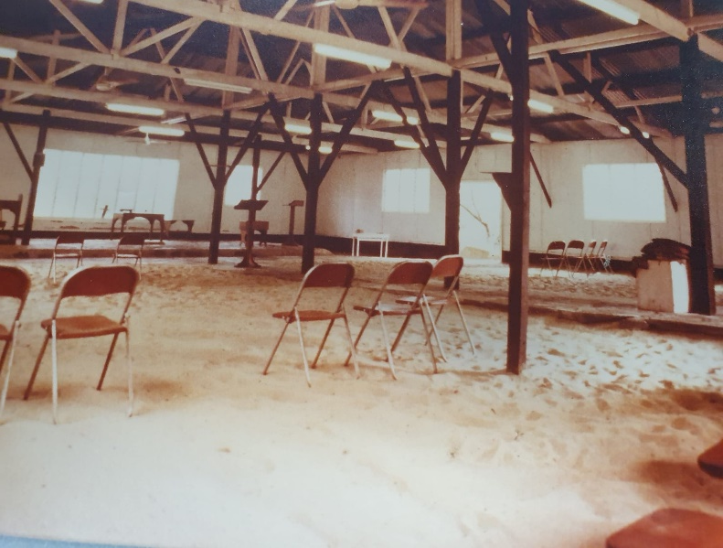
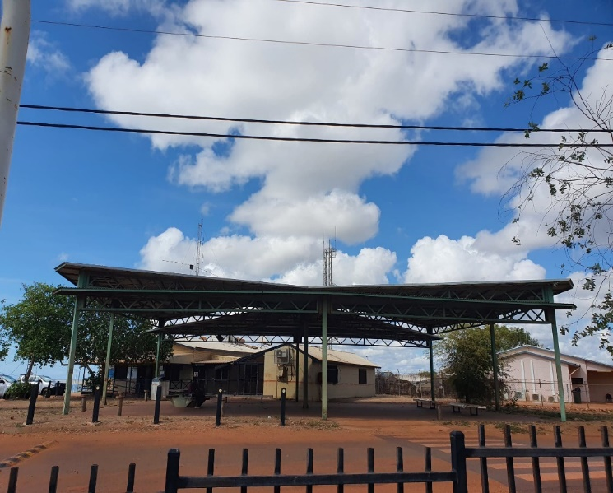
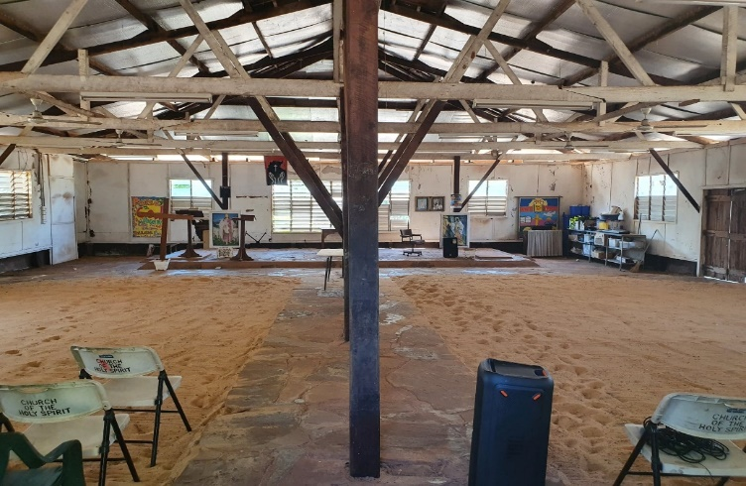
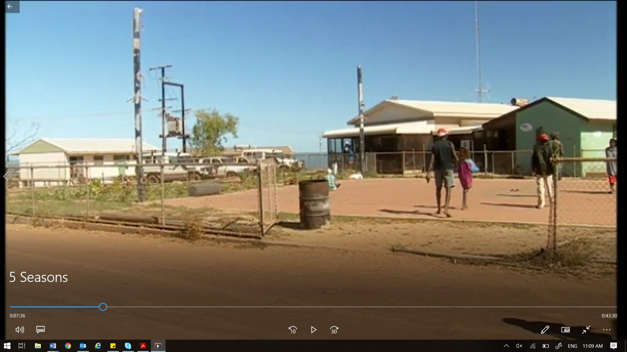
Church + council
past
Present
Council no shade aircon or satellite grass all around no chair or lights church same
Council shade chair no fence built up higher painted aircon light for night church same

Slide 7
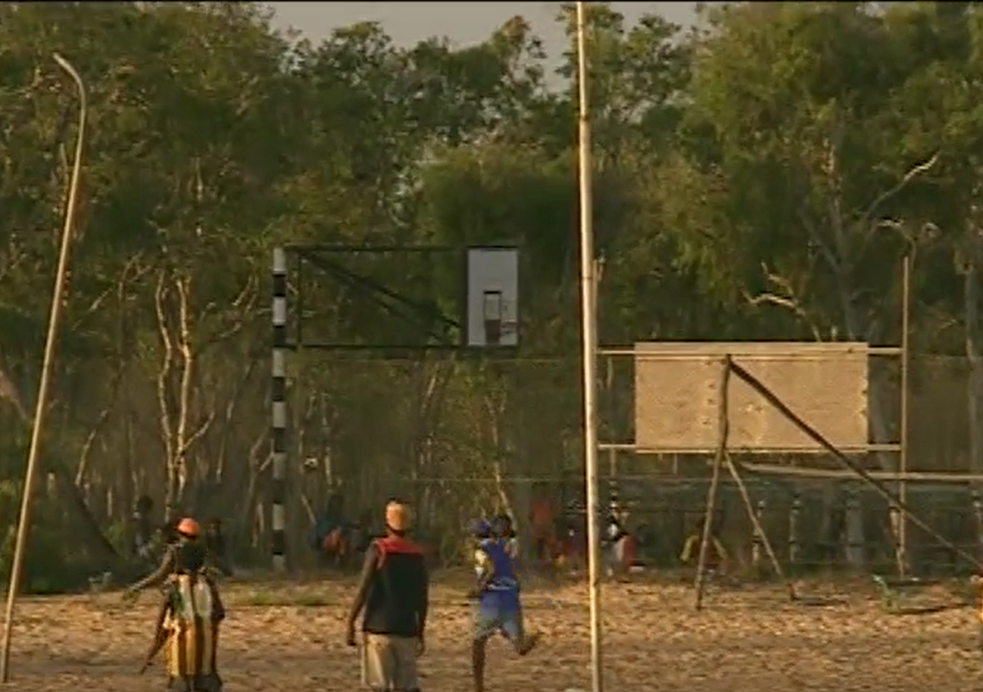
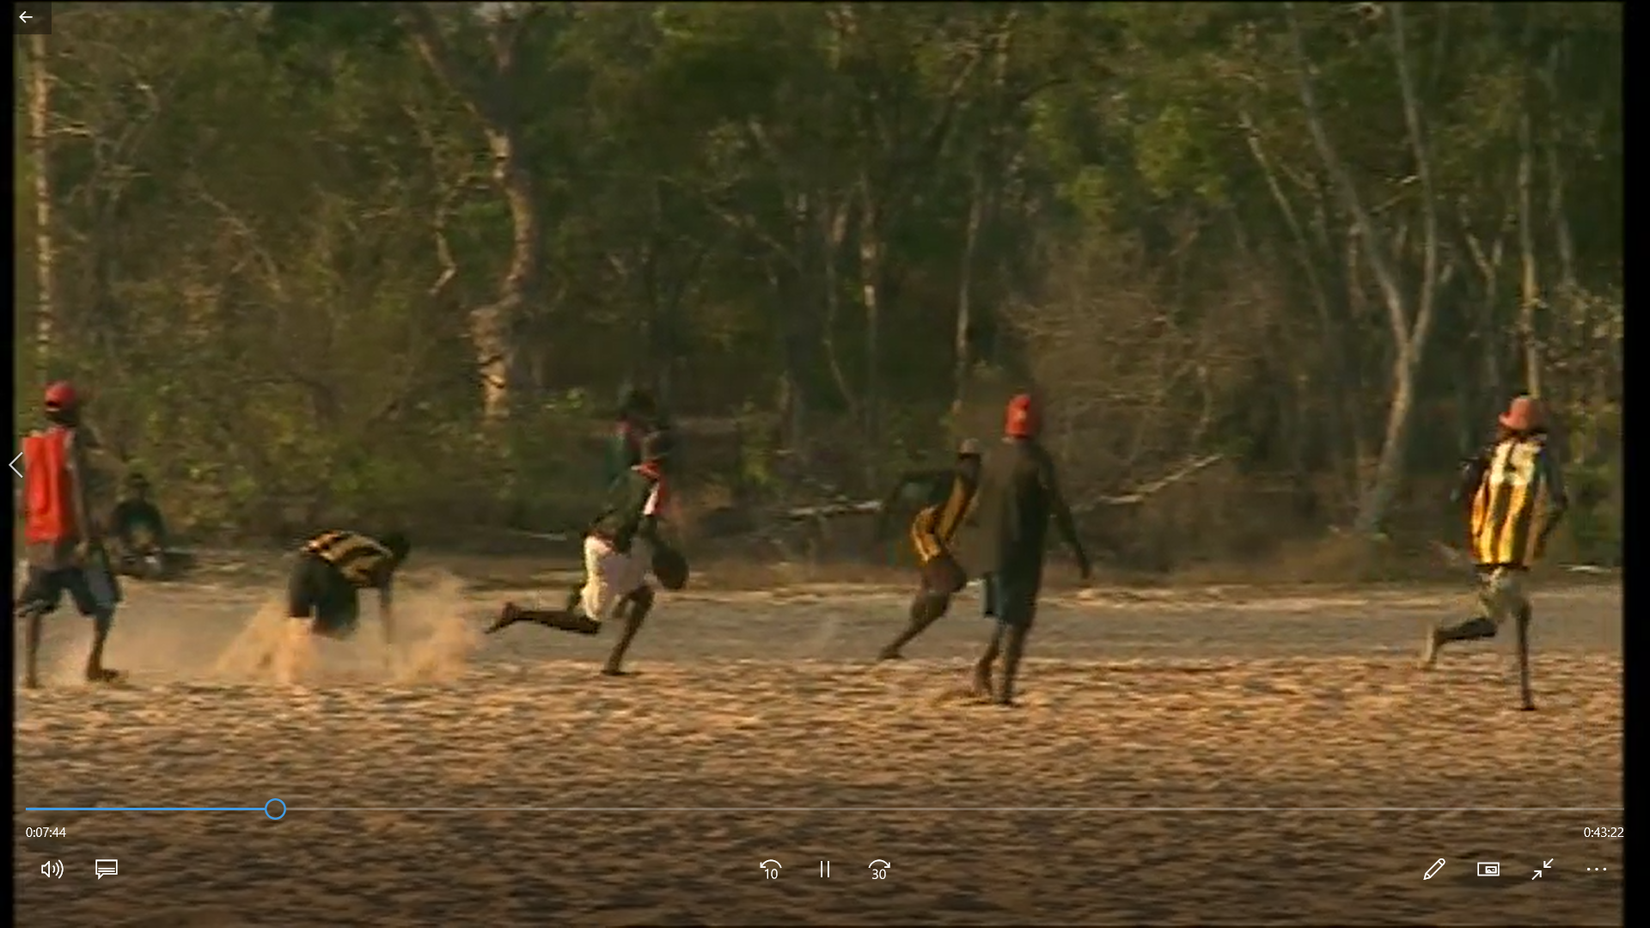
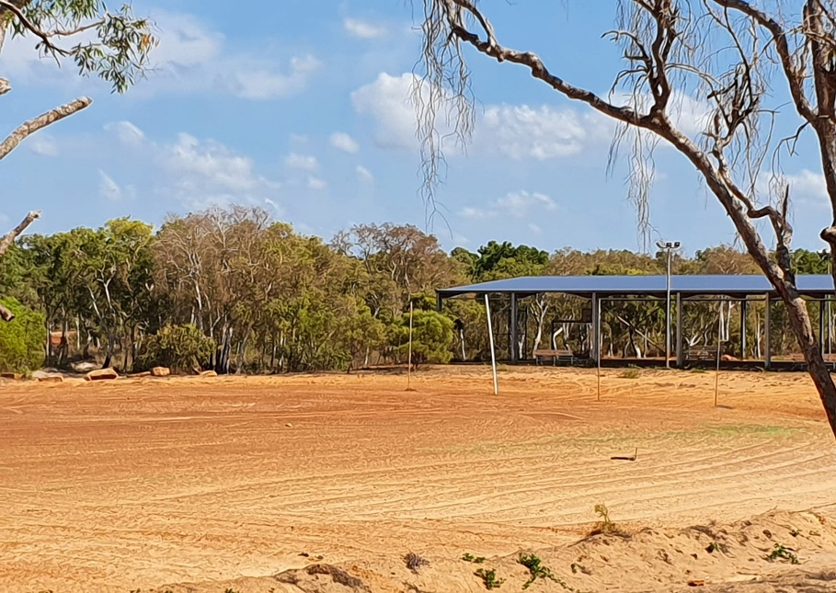
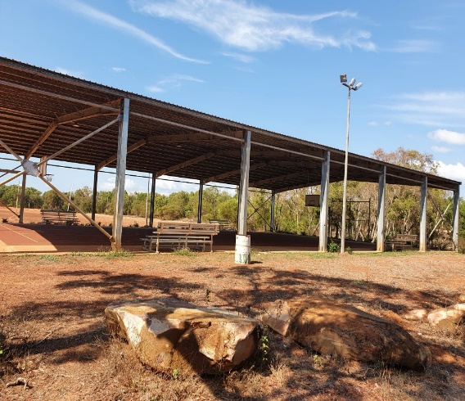
Basketball Court + oval
past
Present
No shade fence around b ball court with painted poll bleachers all down sides of court while smooth floor footy oval all sand
Big shade small chairs metal poll rough concrete floor no fence footy oval made of gravel and red dirt

Slide 8
What I think…
Positive
Negative
More sport stuff
Roads are better so can drive everywhere in truck for fishing
Chairs at basketball cort so lots of people can rest
Shade in some spot and so lots of places for old people to sit down now
Too many fence now
Less tress at school
Tank too low. People fishing can’t see it anymore to know where Numbulwar is.

Slide 9
By Rikannie Nunggo

